Slide 1


Slide 2
Agent
Notes:
(Juli)

Slide 3
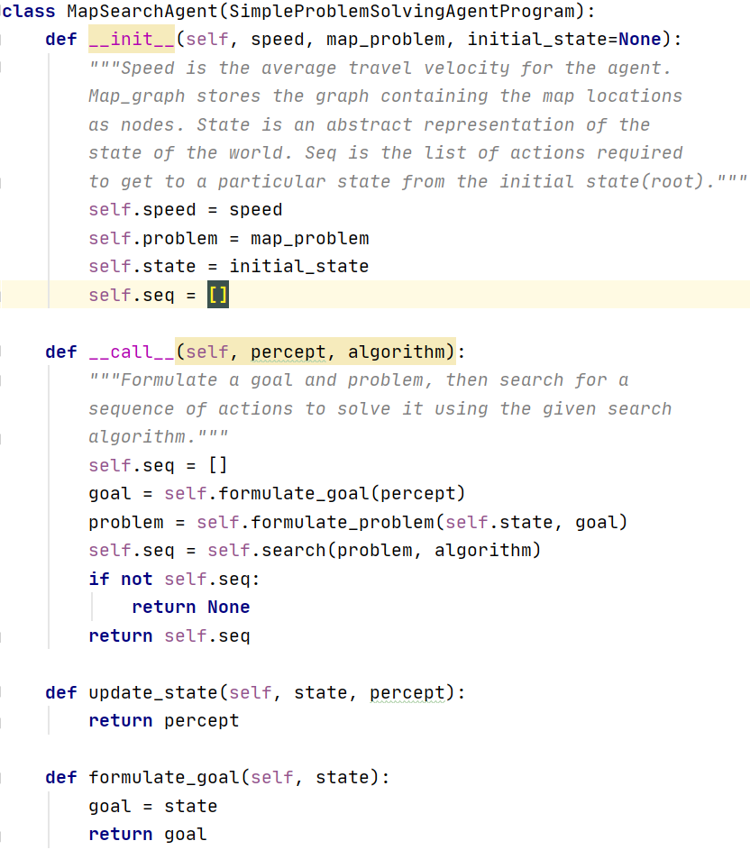
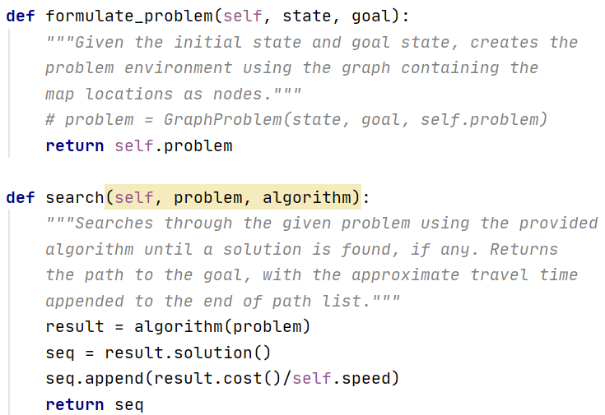
Notes:
(Juli)

Slide 4
A* Search Algorithm
Notes:
(Fernando)

Slide 5
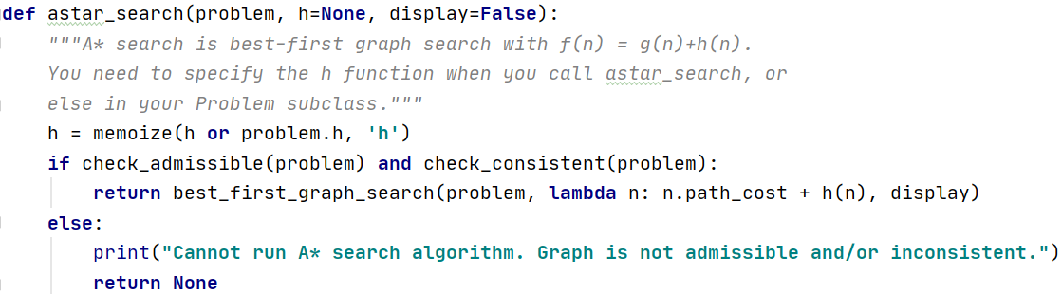
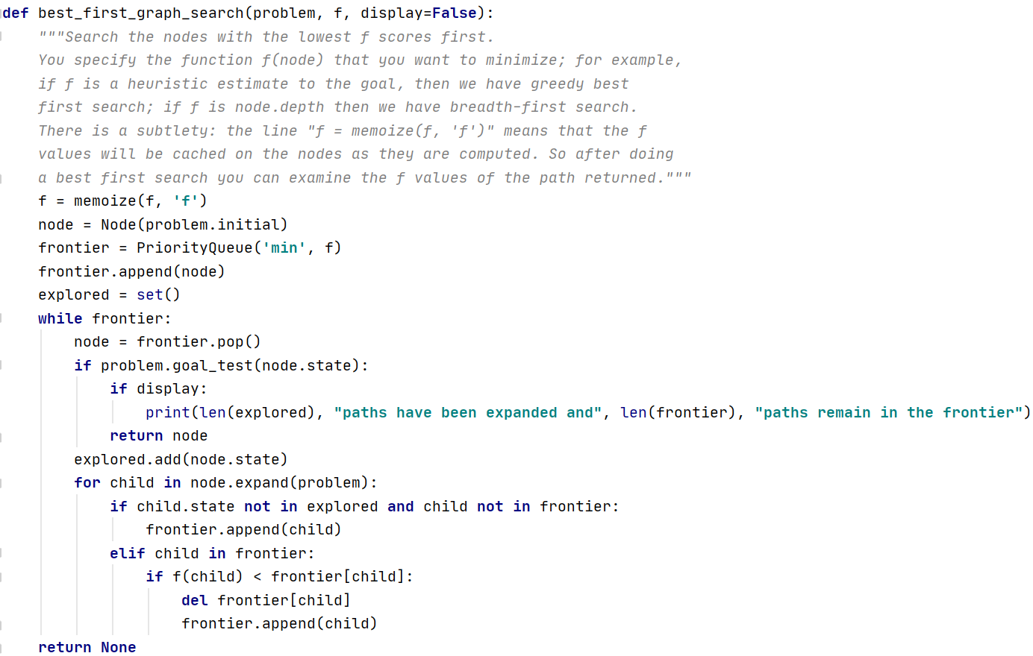
Notes:
(Fernando)

Slide 6
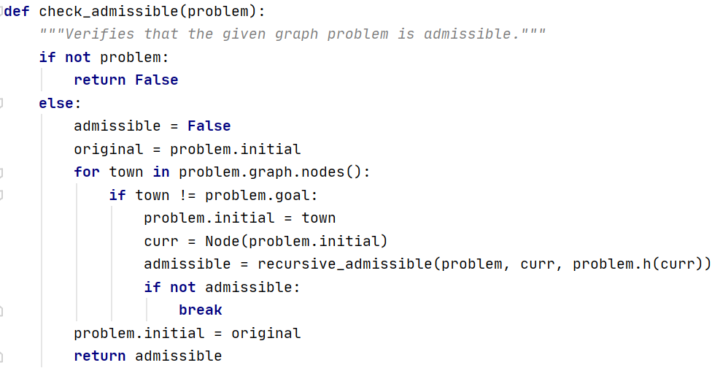
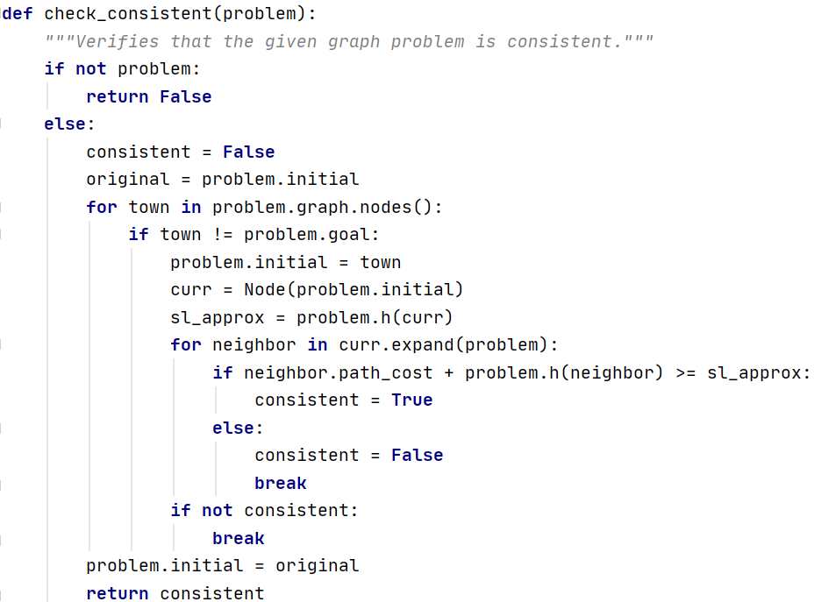
Notes:
(Fernando)

Slide 7
Simulated Annealing
Notes:
(Manuel)

Slide 8
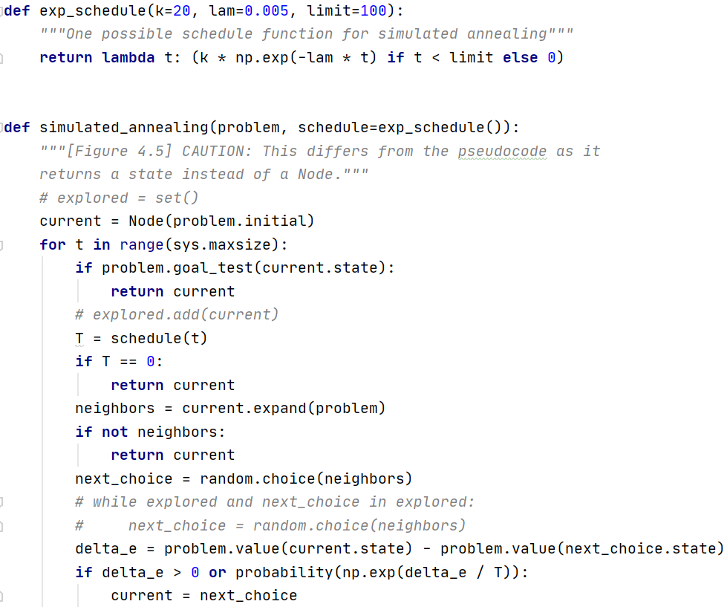
Notes:
(Manuel)

Slide 9
Results
Notes:
(Juli)

Slide 10
RUNNING ANALYSIS for Romania
Average speed for the algorithm 100 KM/H
Romania A* Solution
Travel time: 4.18 Hours
Path: ['Sibiu', 'Rimnicu', 'Pitesti', 'Bucharest']
Romania Simulated Annealing Solution
Travel time: 14.45 Hours
Path: ['Zerind', 'Oradea', 'Zerind', 'Arad', 'Timisoara', 'Lugoj', 'Mehadia', 'Lugoj', 'Mehadia', 'Lugoj', 'Mehadia', 'Lugoj', 'Mehadia', 'Drobeta', 'Craiova', 'Pitesti', 'Bucharest']
Simulated Annealing vs A* performance percentage: -245.69377990430624 %
RUNNING ANALYSIS for Puerto Rico
Average speed for the algorithm 100 KM/H
Puerto Rico A* Solution
Travel time: 1.652 Hours
Path: ['Aguadilla', 'Quebradillas', 'Arecibo', 'Vegabaja', 'Sanjuan']
Puerto Rico Simulated Annealing Solution
Travel time: 4.281000000000001 Hours
Path: ['Aguadilla', 'Lares', 'Aguadilla', 'Lares', 'Arecibo', 'Vegabaja', 'Arecibo', 'Utuado', 'Arecibo', 'Vegabaja', 'Ciales', 'Vegabaja', 'Sanjuan']
Simulated Annealing vs A* performance percentage: -159.14043583535113 %
Process finished with exit code 0
Notes:
(Juli)

